Slide 1
Development and integration of genetic co-essentiality in the Perturbation Catalogue
Genome Assembly and Annotation (GAA) Section Talk
29 June 2026
Stefanus Bernard
Visiting PhD Fellow in the Human Genomics (Perturbation Catalogue) team - European Bioinformatics Institute
www.ebi.ac.uk

Slide 2
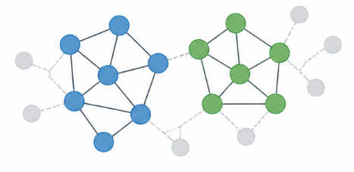
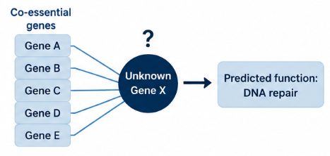
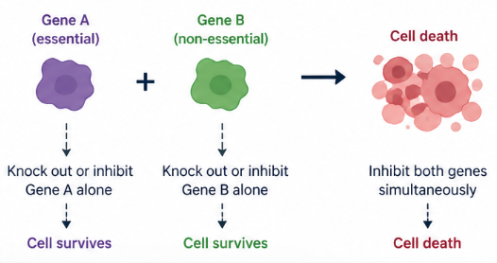
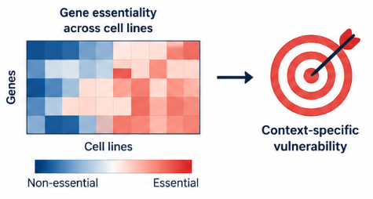
The value of genetic co-essentiality from CRISPR-KO screens
Reveal hidden genetic interaction that help in the identification of novel pathways or complexes
(Rainey et al., BioRXiv, 2025)
Predict the biological function of less characterized genes (Wainberg et al., 2021)
Find context-specific genetic vulnerabilities in cancer, valuable for therapeutic target
Help uncover synthetic lethality relationship for cancer precision medicine (Billmann et al., 2026)
1
Notes:
Previous work has established that co-essential genes are likely to be functionally related and work together in the same pathway. This represents unbiased systematic approach to identify functional relationships between genes

Slide 3
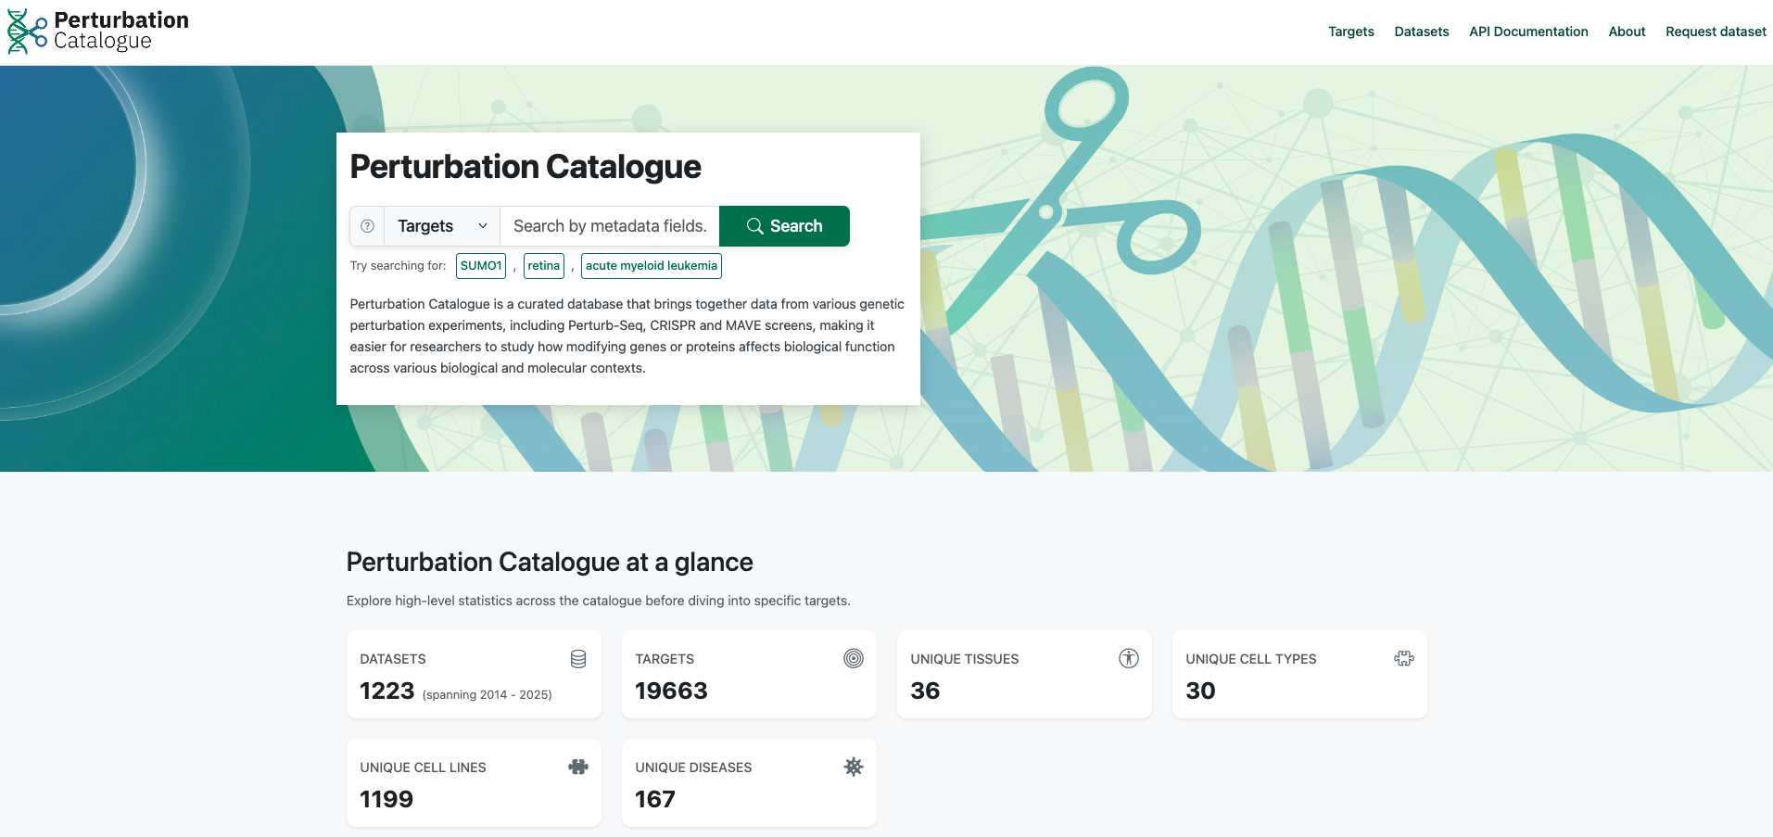
Perturbation Catalogue: a curated database of various genetic perturbation experiments
Proposed visiting PhD project: Integration and development of genetic co-essentiality in the Perturbation Catalogue platform
2

Slide 4

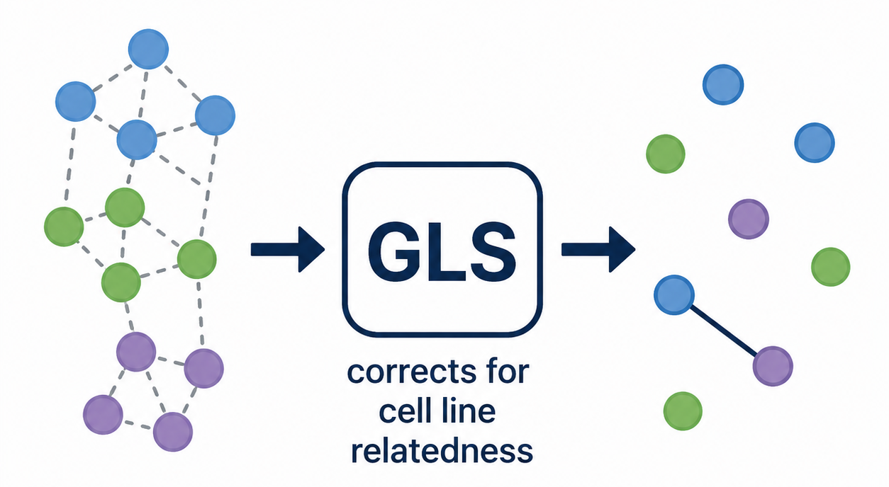


Integration and development of gene co-essentiality in the Perturbation Catalogue platform
Generalised Least Squares incorporate covariation between every pair of screens (Wainberg et al 2021). Output a data list of co-essential gene pairs
~1,000 CRISPR-KO screens from different cancer subtypes (DepMap 26Q1)
DepMap data checked/updated every month using DepMap API
Gene essentiality matrix
Gene A
Gene B
Gene 1
Gene 2
Gene 3
Single-gene view
A table listing top co-essential gene pair (single-gene view) and a STRING-network-style of gene co-essentiality
Multi-gene view
STRING network-style of gene co-essentiality and Gene Ontology Biological Process (GO:BP) annotation
3
Notes:
Standard pearson correlation assume each data are independent, while in some cancer cell lines are from the same tissues which they may have similar genetic background. This biological relatedness between cell lines can inflates Pearson’s correlation p-values.
The generalized least squares accounts for the non independence of cell lines by incorporating information about the covariation between every pair of screens
Duplicating each point 10 times with slight noise (analogous to duplicating each screen in 10 related lines) makes the previously non-significant (p = 0.6) blue correlation highly significant (p = 0.007) and the significant red correlation (p = 7 × 10⁻⁵) substantially more so (p = 2 × 10⁻¹⁰³), despite similar correlation magnitudes.
The standard pearson correlation assuming all cancer cell lines independent. In fact, they are not independent from each other. For example like all breast cancer cell lines share a common genetic backgrounds, and in the standard pearson correlation, this can inflate the correlation value. GLS correct this by capturing how similar every pair of cell lines to every other pair across all genes. GLS will de-correlates the cell lines and block the highly similar cell lines that contribute to the same statistical weight as a single independent observation

Slide 5

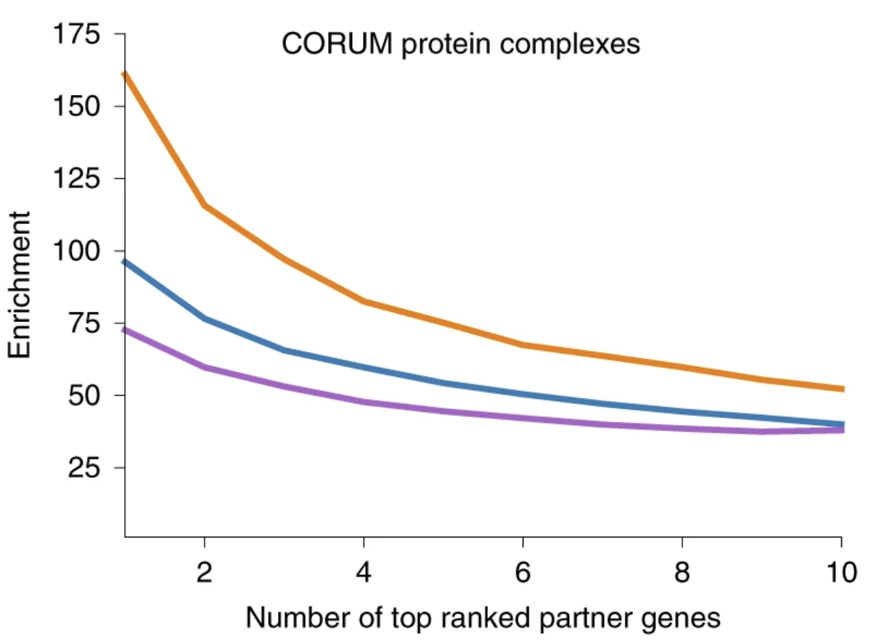
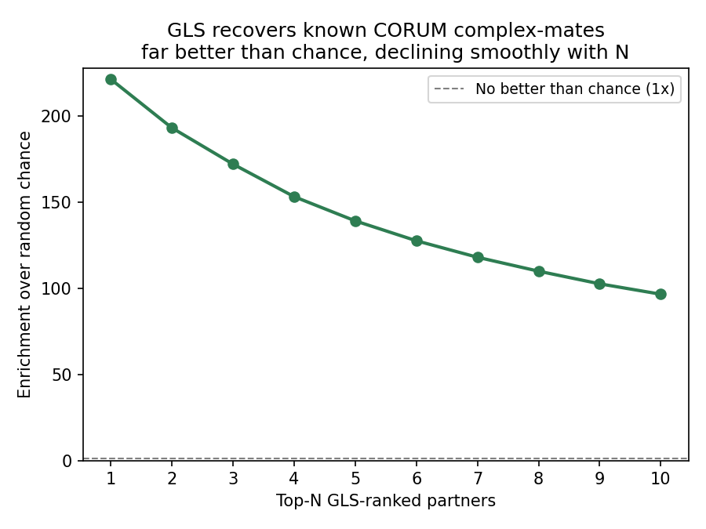
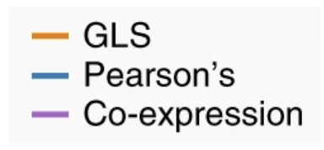
DepMap GLS pipeline benchmark validation by using CORUM dataset
Does our GLS co-essentiality pipeline finds a real biology or just a noise ?
CORUM is a curated dataset of experimentally verified protein complexes, Wainberg et al (2021) used this as an independent ground truth
Genes that are co-essential are likely to be functionally related and work together in the same pathway
Wainberg et al, 2021
Our validation approach
Wainberg et al (2021) performed a validation, by iterating in each gene and rank the partner by GLS significance, and check whether top-ranked partners are known co-complex in CORUM
Our validation attempt showed that top ranked partner genes are highly enriched for CORUM curated protein complexes
4

Slide 6

Single-gene view workflow of genetic co-essentiality in the Perturbation Catalogue
User input gene symbol and select FDR threshold (5% or 10%)
Column | Row | GLS P-value | FDR
Gene 1 | Gene 2 | <0.05 | <0.1
Gene 1 | Gene 3 | <0.05 | <0.1
… | … | … | ...
Gene n | Gene n | <0.05 | <0.1
A table listing top co-essential gene pair requested by user (can be downloaded)
DepMap GLS pipeline obtain DepMap gene effect score data once a month, run GLS and produce the GLS table
Gene 1
Gene 2
GLS table containing pair of gene co-essentiality is stored in the back end
Gene 3
Co-essential genetic interaction network pivoted to a single gene
Back-end Perturbation Catalogue
Front-end Perturbation Catalogue
5

Slide 7
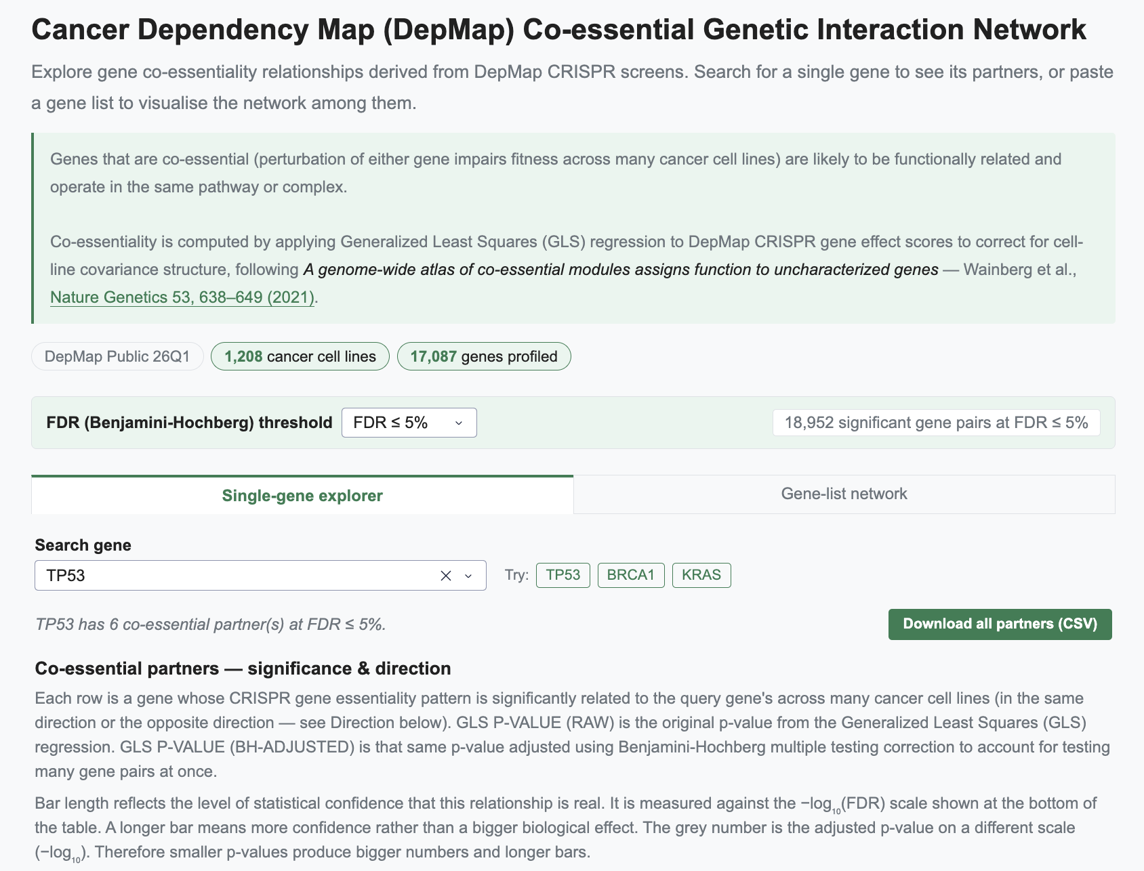
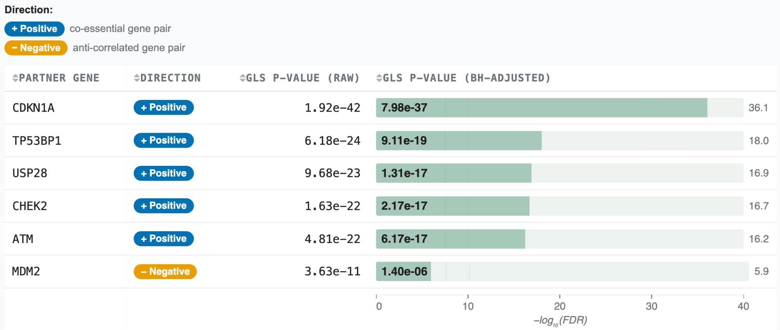
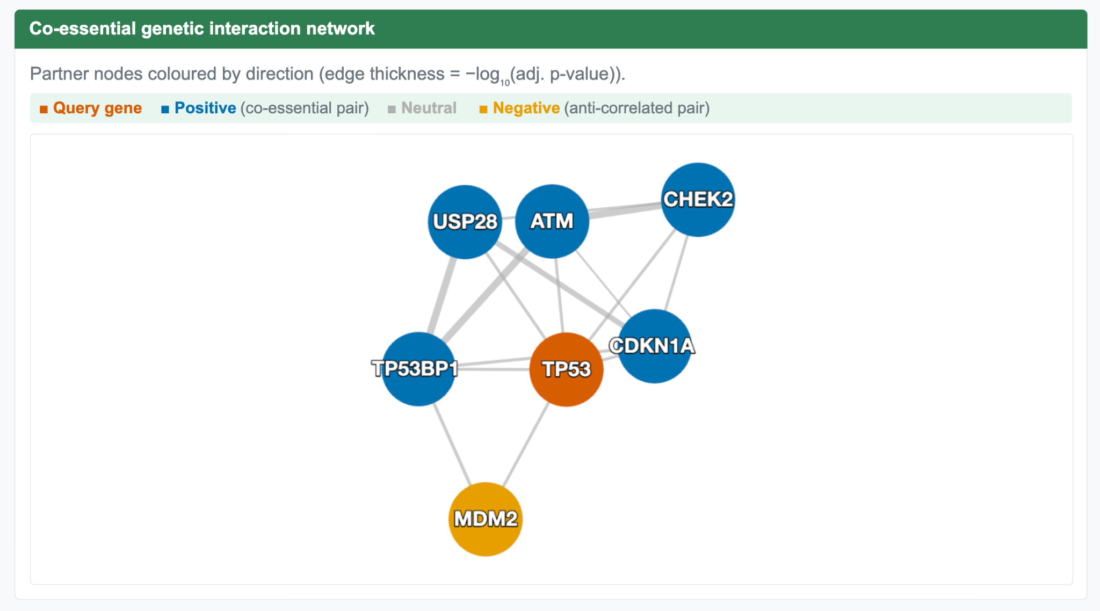
Single-gene view user interface in the Perturbation Catalogue
Table of top co-essential partners from single-gene view
Select FDR 5% or 10%
Allow user to select specific gene of interest (single-gene view)
Co-essential network visualized using dash cytoscape package
6

Slide 8
Multi-gene view workflow of genetic co-essentiality
User input several genes (e.g gene hits from CRISPR-KO screens)
Gene 1
Gene 2
Column | Row | GLS P-value | FDR
Gene 1 | Gene 2 | <0.05 | <0.1
Gene 1 | Gene 3 | <0.05 | <0.1
… | … | … | ...
Gene n | Gene n | <0.05 | <0.1
Gene 3
Co-essential genetic interaction network will be created from all input genes (activated after user input list of genes)
DepMap GLS pipeline obtain DepMap gene effect score data once a month, run GLS and produce the GLS table
GLS table containing pair of gene co-essentiality is stored in the back end
A table of enriched cluster based on Gene Ontology Biological Process (GO:BP) (activated upon user click a button)
Separately a table containing curated Gene Ontology Biological Process obtained from https://geneontology.org/ (downloaded once - update check is performed manually)
Front-end Perturbation Catalogue
Back-end Perturbation Catalogue
7

Slide 9
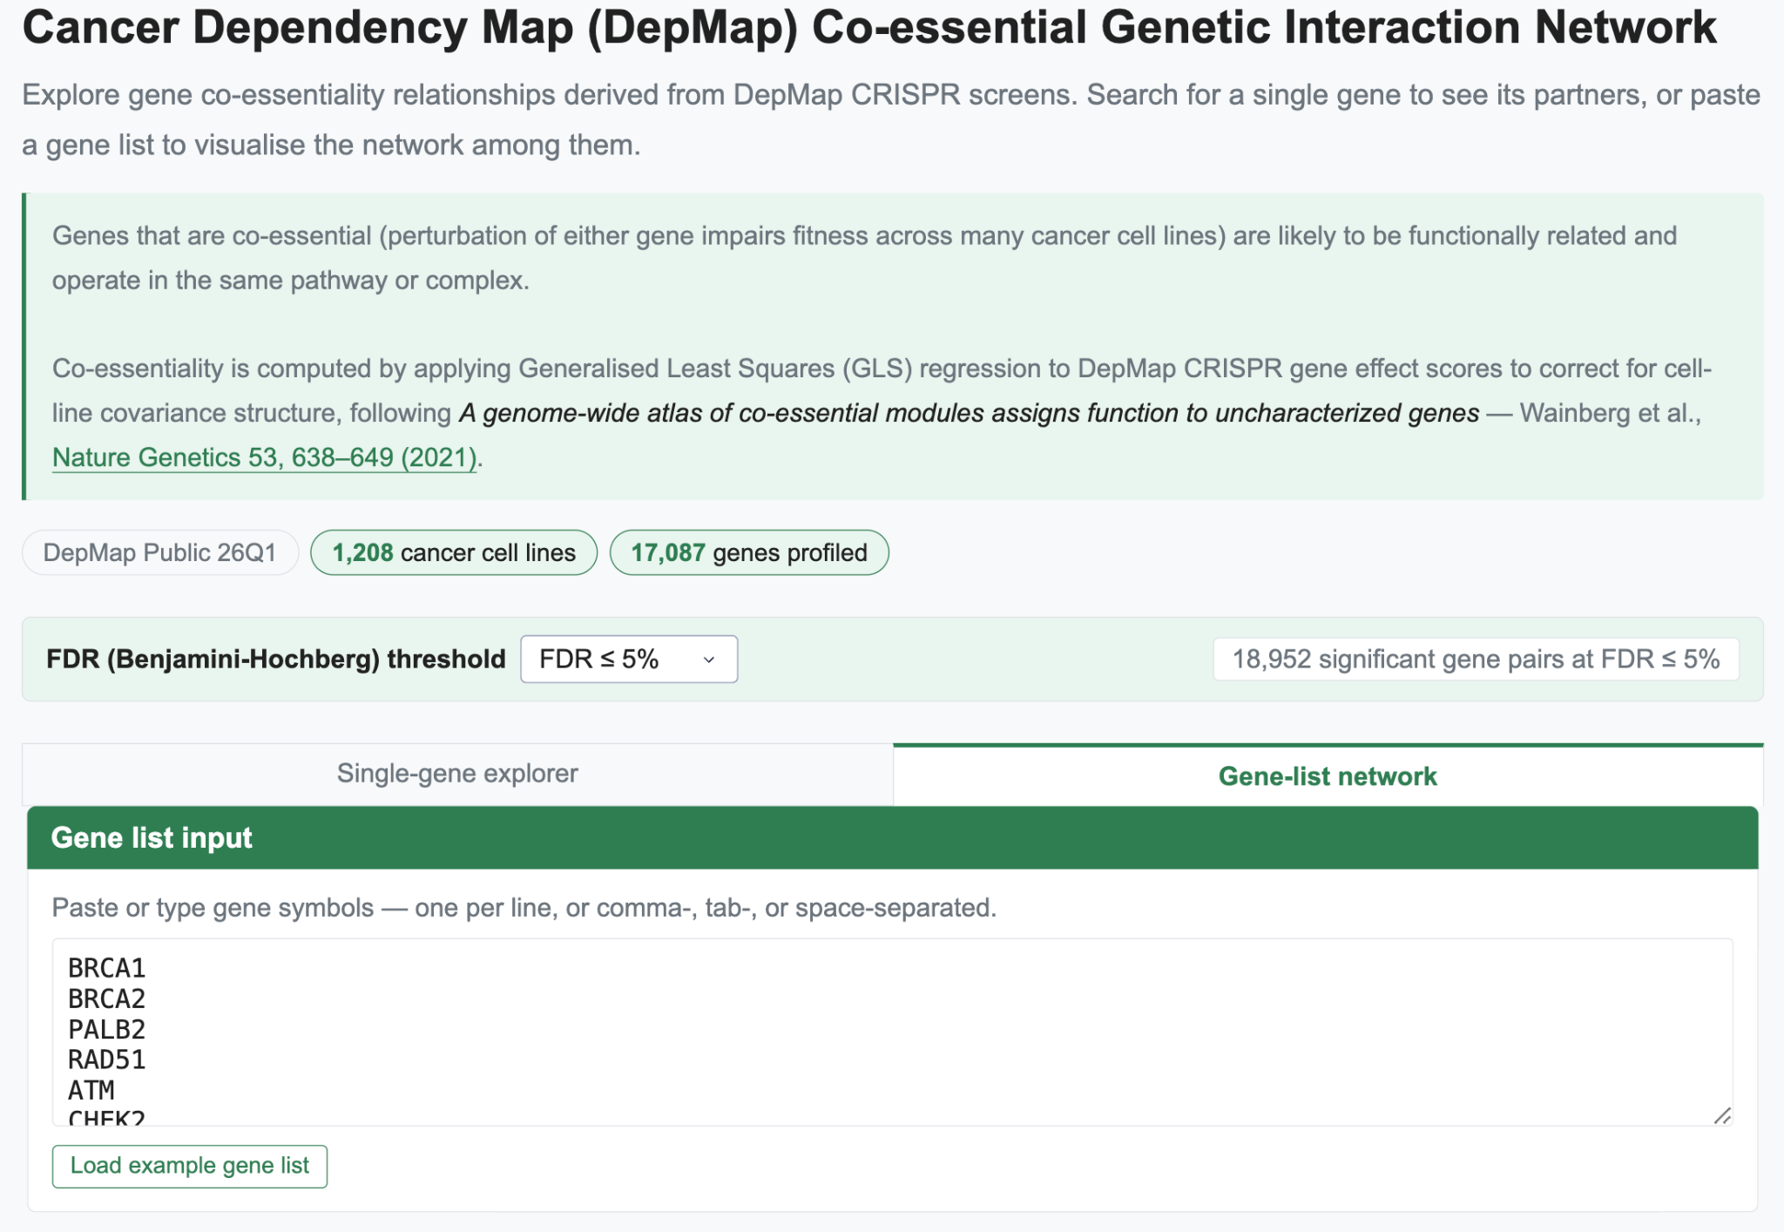
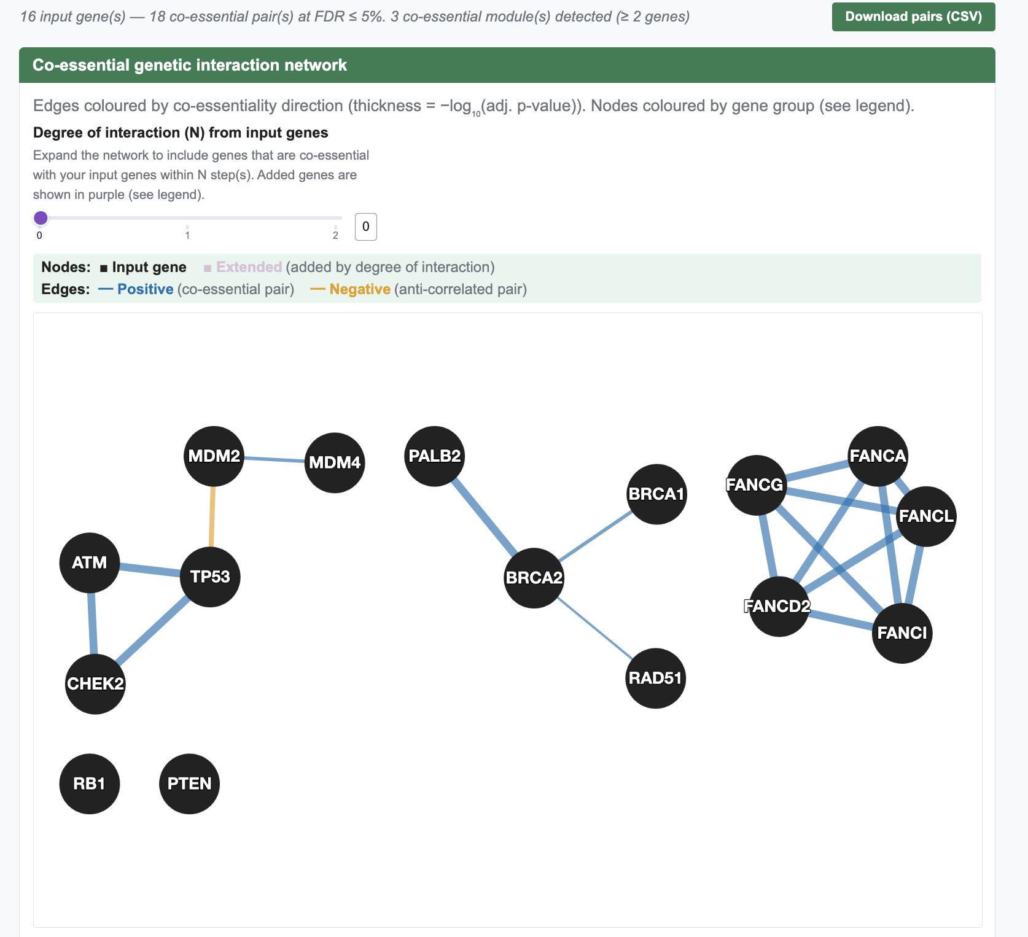
Multi-gene view user interface in the Perturbation Catalogue
Allow user to input list of genes of interest (e.g CRISPR-KO screens gene hits)
In this example, we use the “Load example gene list”
Co-essential genetic interaction network from input list of genes
8

Slide 10
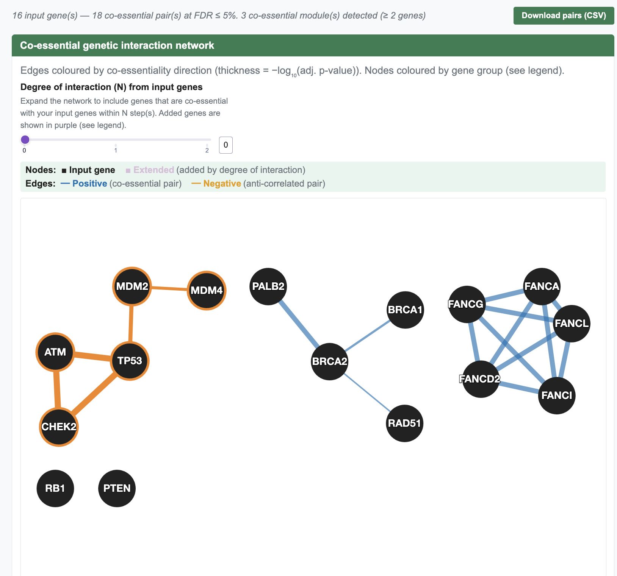
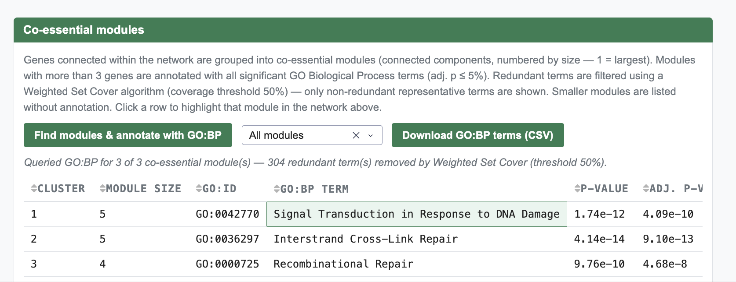
Annotation of each co-essential modules based on gene ontology biological process
Co-essential modules annotated using GO:BP, modules highlighted when user click the corresponding annotation field
Co-essential genetic interaction network from input list of genes
9

Slide 11
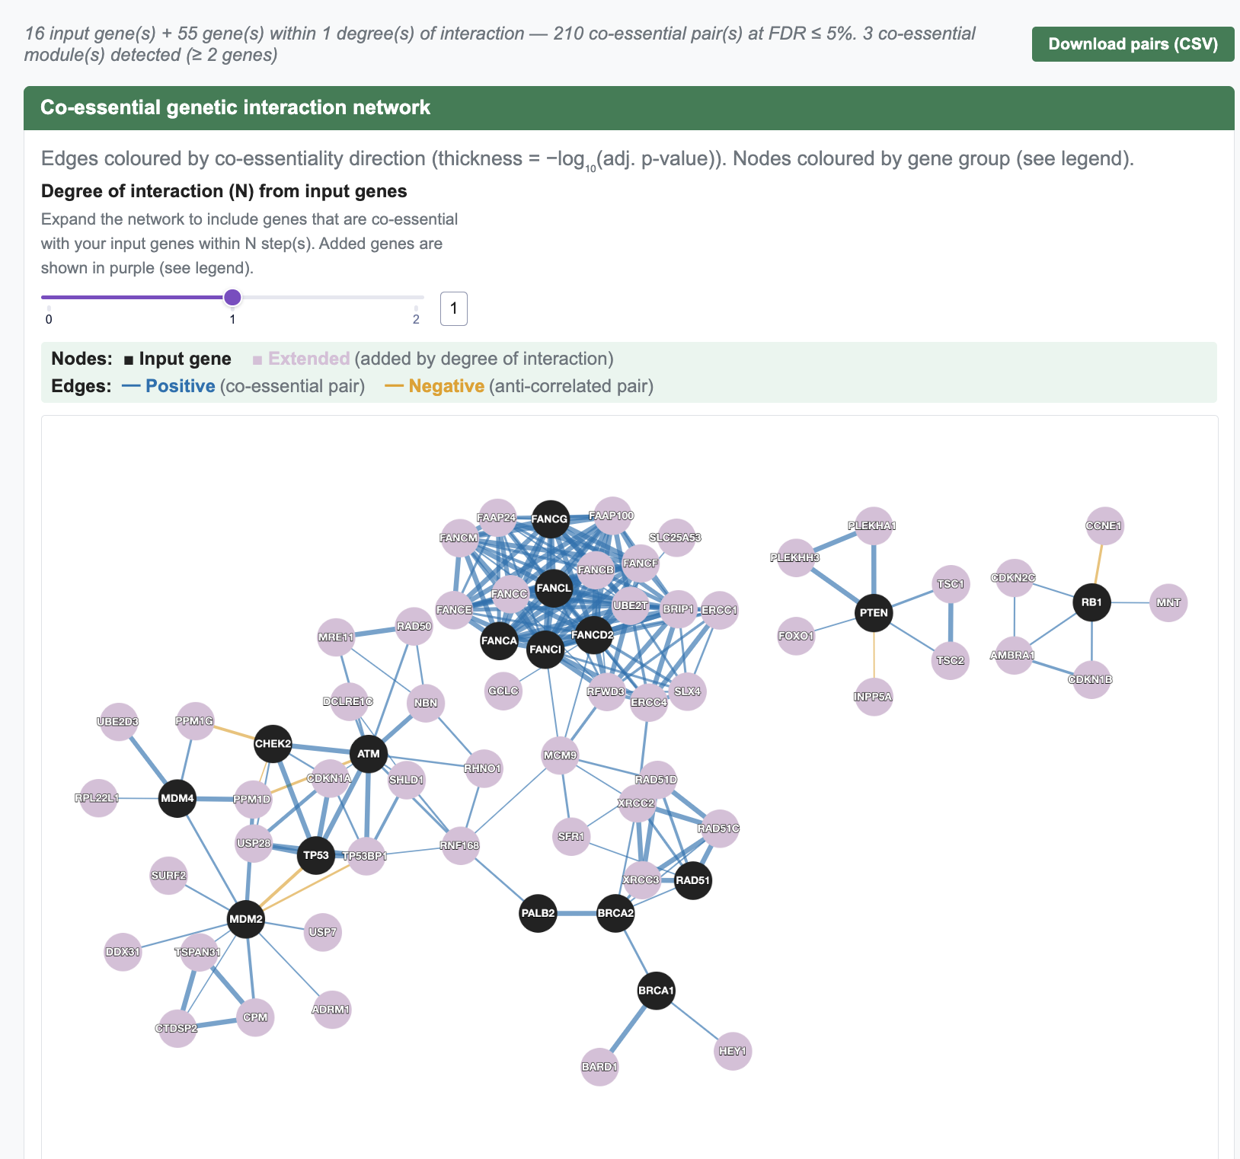
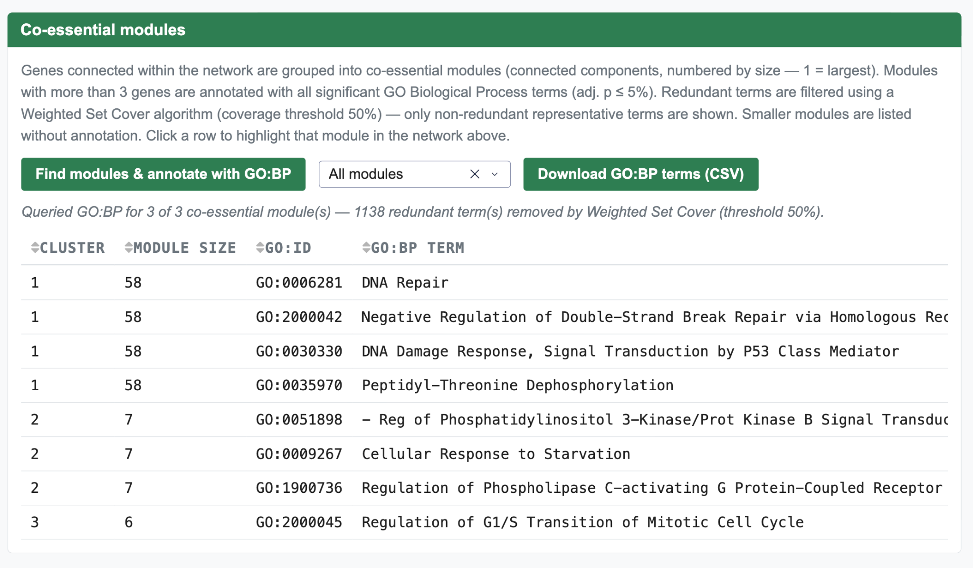
Extended co-essential network can be used to identify complex membership of disconnected gene pair
Co-essential modules annotated using Gene Ontology Biological Process (GO:BP)
Co-essential genetic interaction network from input list of genes + 1 degree extended interaction
10

Slide 12




Acknowledgement
Santocanale Laboratory
Prof. Corrado Santocanale
Dr. Michael D. Rainey
Dr. Yeray Hernandez Reyes
Dr. Aline Morrison
Dr. Pouya Abrari
Liadhan Farrell
UCD Cancer Data Lab
Dr. Colm J. Ryan
Dr. Metin Yazar
Dr. Olivier Dennler
Narod Kebabci
Carlos V. Rodriguez
Human Genomics (Perturbation Catalogue)
Dr. Mallory Freeberg
Dr. Aleksandr Zakirov
Alexey Sokolov
Kirill Tsukanov
Special thanks to #gaa-coffee-club and the fantastic coffee machine :)
This presentation has emanated from research conducted with the financial support of Research Ireland under Grant number [18/CRT/6214]
11

Slide 13
Thank you, any questions?
Stefanus Bernard
Visiting PhD Fellow
Human Genomics team (Perturbation Catalogue)
www.ebi.ac.uk

